Slide 1

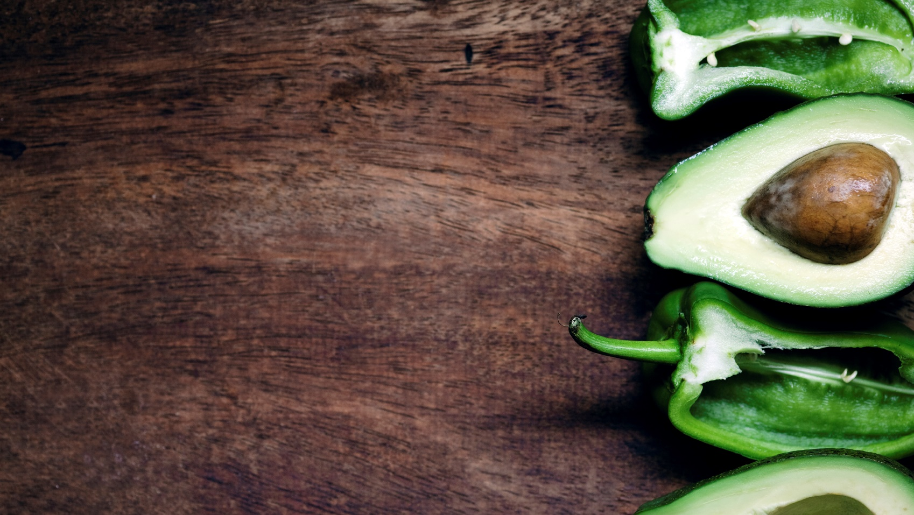
Plant Disease Detection
Under Mentorship of
Dr. Satyajit Das and Mr. Bhavesh Ram
-by Satyadev Subudhi

Slide 2
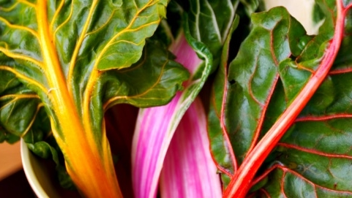

Problem Statement
*Description:* This dataset consists of images of plants with and without diseases, labeled with the type of disease. We need to build a model which can predict the type of disease from a given picture with high accuracy.
*Source:* [Plant Village Dataset](https://plantvillage.psu.edu/datasets)
*Example Dataset:* [Plant Village Disease Classification](https://www.kaggle.com/datasets/emmarex/plantdisease)
Note: I have used a subset of dataset for model training and testing

Slide 3
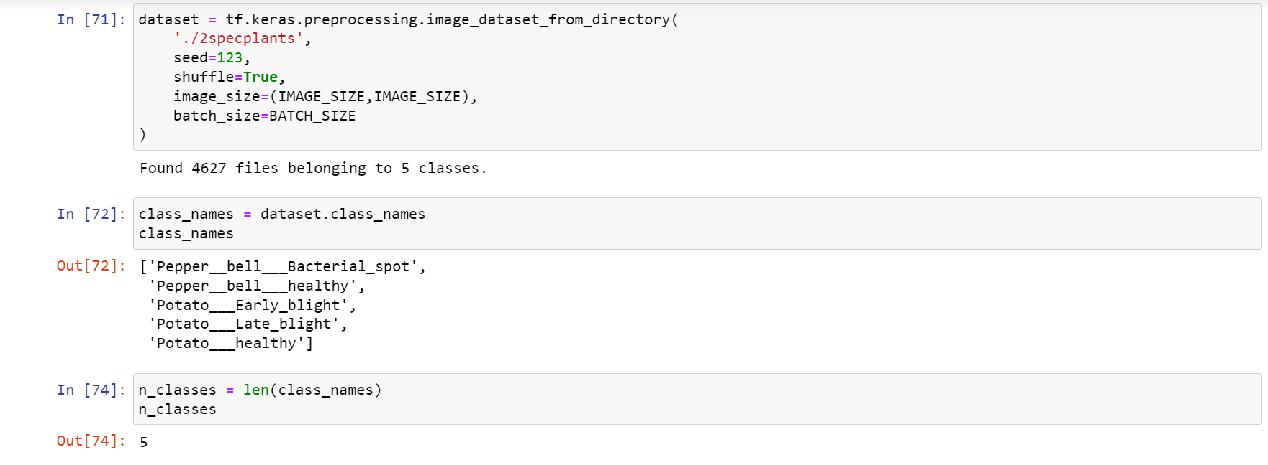
Initialization
Loading a subset of data (Too much computation for entire dataset ) which contains Pepper and Potato leaf images

Slide 4
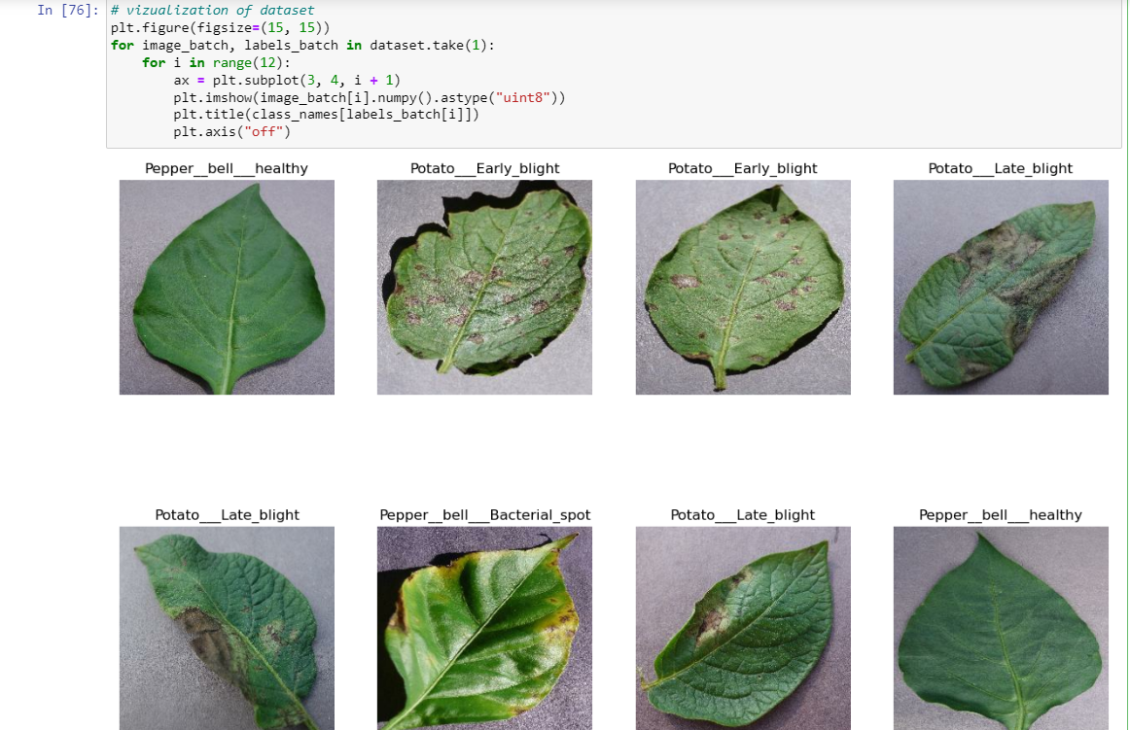
Vizualisation of the dataset

Slide 5
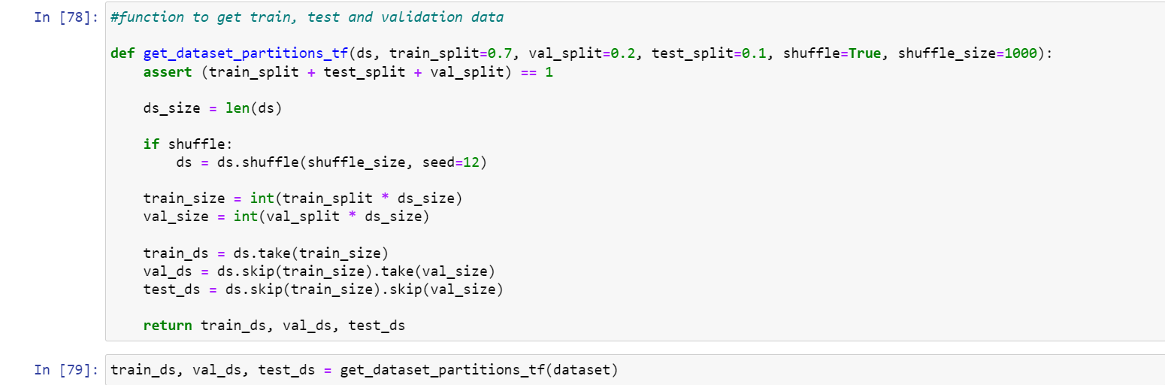
Splitting dataset into 3 partitions
Training set = data which will be used for training model (70%)
Validation set = data to tested on while training (20%)
Testing set = data to tested on after training is done (10%)

Slide 6
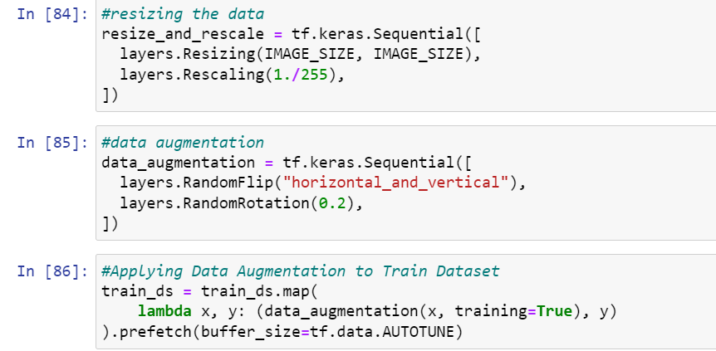
Resizing the data and performing data augmentation
Scaling the data and performing data augmentation (Rotating and flipping images)

Slide 7
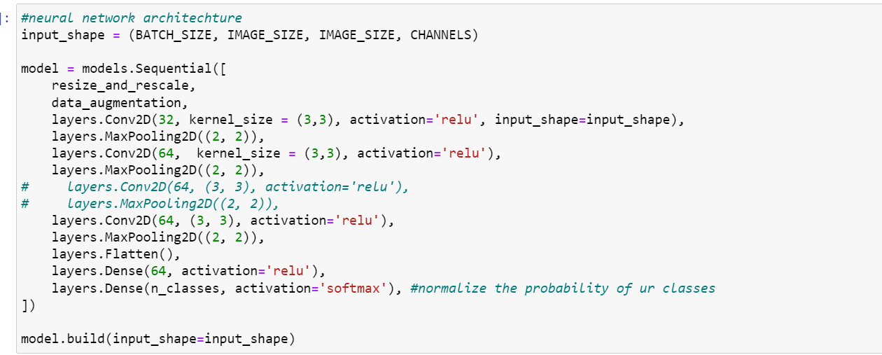
Model Architechture
CNN model is used with multiple layers for better accuracy

Slide 8
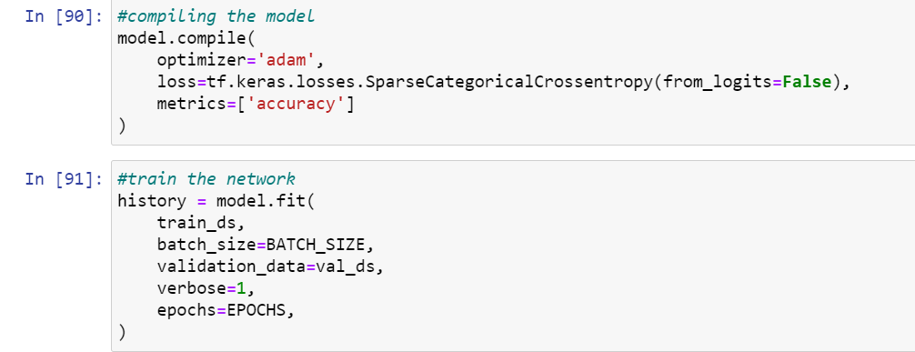
Compiling model and testing it

Slide 9
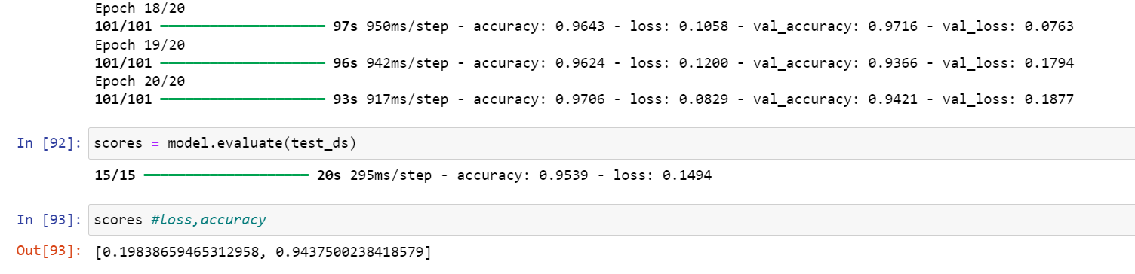

Slide 10
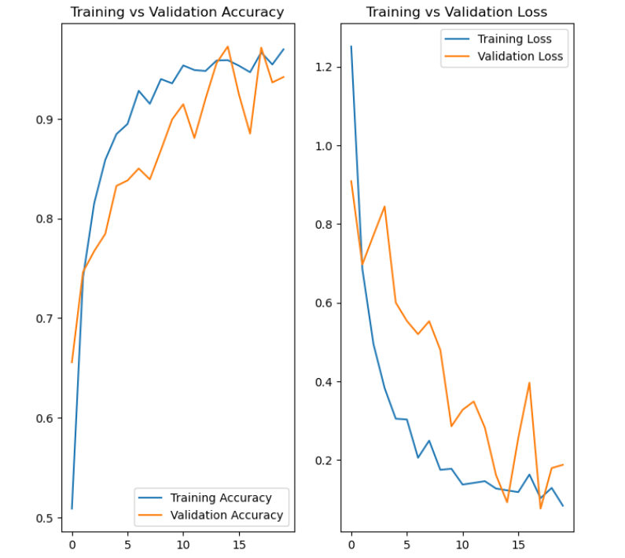
Training and validation plots

Slide 11
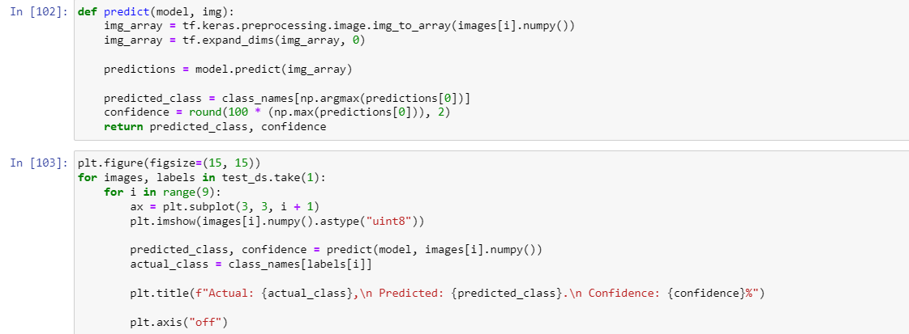
Code for Testing on custom input

Slide 12
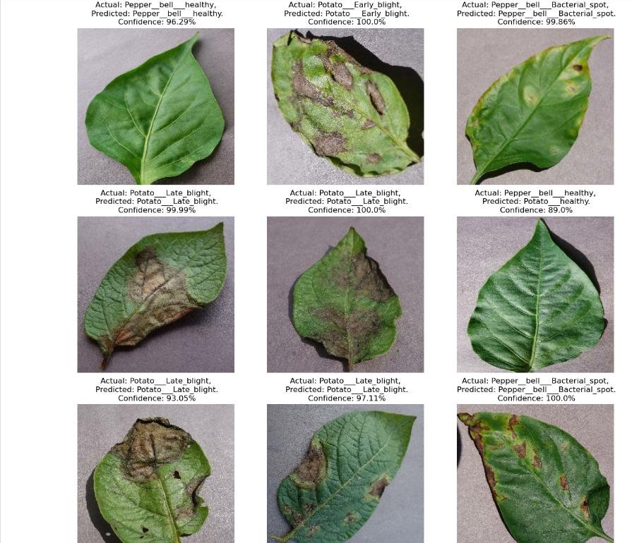

Slide 13
Optimizations that can be performed:
We can add more layers in model to improve accuracy of model
We can increase number of EPOCHS so that we get more accurate weights
We can chose training, validation and testing to be 60,20,20 resp for large data
We can increase batch size in case of larger dataset
GPU can be used for faster compiling and model fitting

Slide 14
Thank you

